Slide 1
Smart Waste Management
Project Submitted BY : Hemeshwarraj V
Akanksha Mehta
Yash Chitrang

Slide 2
Introduction
Garbage monitoring is an essential issue for most of the cities in India. The current garbage monitoring and management system are ineffective contributing to high transportation and collection costs. Due to poor monitoring and collection, garbage bins are seen overflowing in certain areas which can lead to long-term problems such as bad odor and garbage harmful diseases. On the contrary, in some places, garbage collection trucks end up collecting from bins which have low garbage levels leading to high petrol consumption and increased air pollution. In the current garbage management and disposal system, the litter bins allotted for each locality or each street are emptied by cleaners at regular intervals of time.

Slide 3
Why We need it
The main concerns with our environment has been solid waste management which impacts the health and environment of our society. The detection, monitoring and management of wastes is one of the primary problems of the present era. The traditional way of manually monitoring the wastes in waste bins is a cumbersome process and utilizes more human effort, time and cost which can easily be avoided with our present technologies.

Slide 4
Software Used
IBM Cloud
Watson IBM IoT Services
Node Red Application
FAST2SMS API
MIT App Inventor

Slide 5
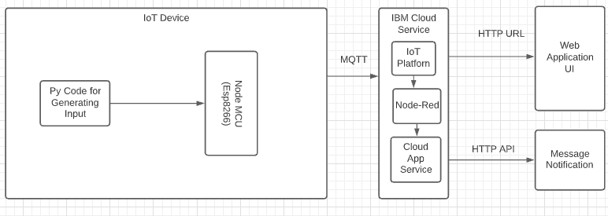
Block Diagram

Slide 6
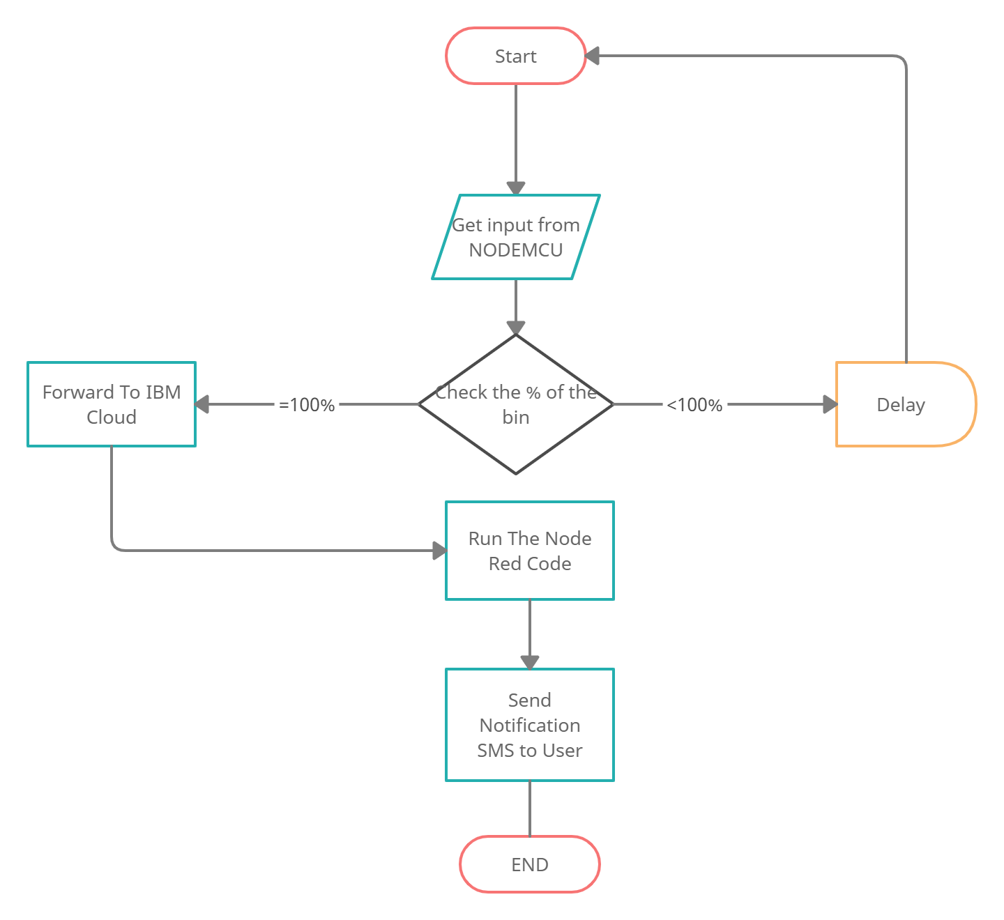
flowchart

Slide 7
Advantages
Time consumption is less.
Fuel consumption is optimized.
Air pollution from garbage collection trucks and due to foul smell is reduced.
Fill level-based garbage collection route mapping is employed.
Real-time and live data from the garbage bin can be obtained.

Slide 8
Disadvantages
System requires more number of waste bins for separate waste collection as per population in the city. This results into high initial cost due to expensive smart dustbins compare to other methods.
Sensor nodes used in the dustbins have limited memory size.
It reduces man power requirements which results into increase in unemployment for unskilled people.

Slide 9
Bibliography
Namakambo Muyunda, Muhammad Ibrahim “Arduino-based Smart Garbage Monitoring System Analysis Requirement and Implementation” in 978-1-5386-0765- 7/17/$31.00 ©2017 IEEE
Dr.N.Sathish Kumar, B.Vijayalakshmi, R. Jenifer Prarthana, A.Shankar “IOT Based Smart Garbage alert system using Arduino UNO” in 978-1-5090-2597- 8/16/$31.00_c 2016 IEEE

Slide 10
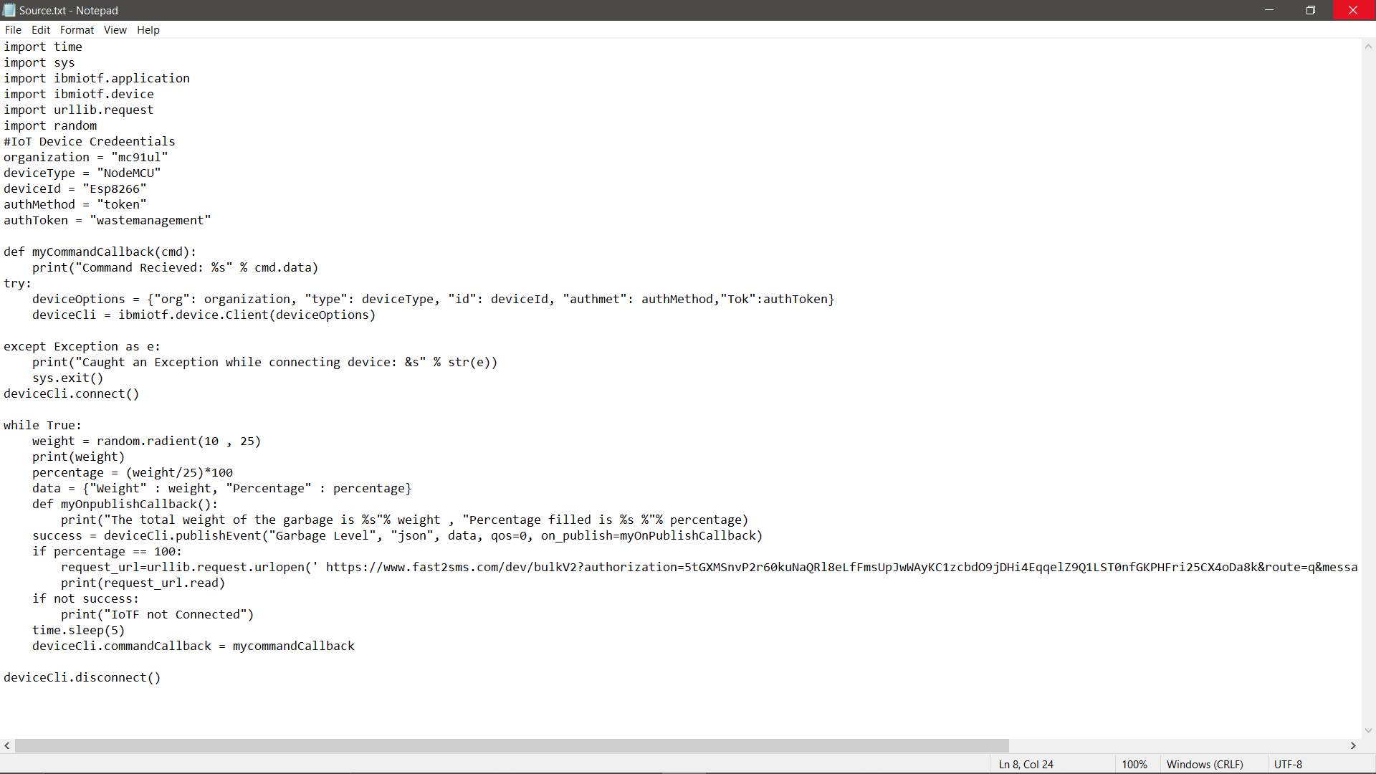
Source Code

Slide 11

Notification Output

